Slide 1

TRƯỜNG ĐẠI HỌC CÔNG NGHỆ THÔNG TIN
KHOA CÔNG NGHỆ PHẦN MỀM
SE102- NHẬP MÔN PHÁT TRIỂN GAME
High School Profile Management
Giảng viên hướng dẫn: Đinh Nguyễn Anh Dũng
Sinh viên thực hiện: Trần Anh Khoa
Lớp: SE102.L22.PMCL

Slide 2
Contents
Contents
Introduction
Solution
Evaluation

Slide 3

Introduction

Slide 4
Introduction
This is a game Mario using library directx 12.
Language : C++ .

Slide 5



Introduction
Main character : mario
Enemies : Goomba GoombaW Koopas

Slide 6

2.Solution

Slide 7
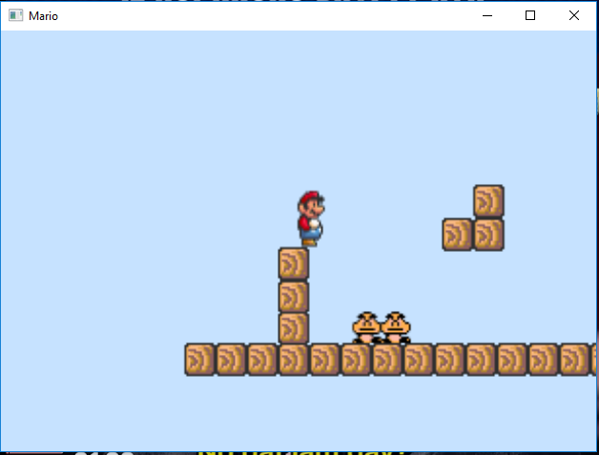
Solution
World 1.
Press space to jump(you can jump twice).
to move right.
to move left.

Slide 8
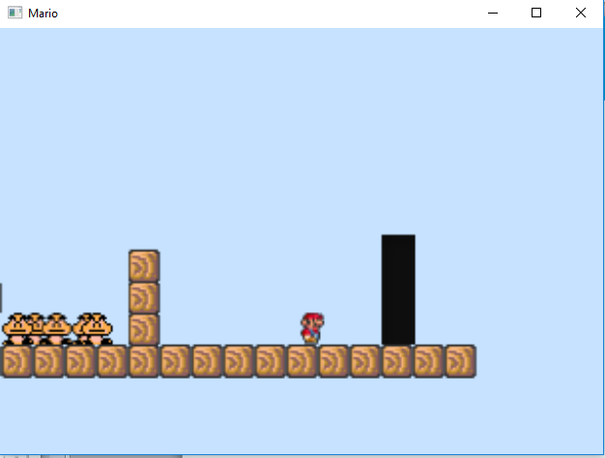
Solution
Mario meet portal

Slide 9
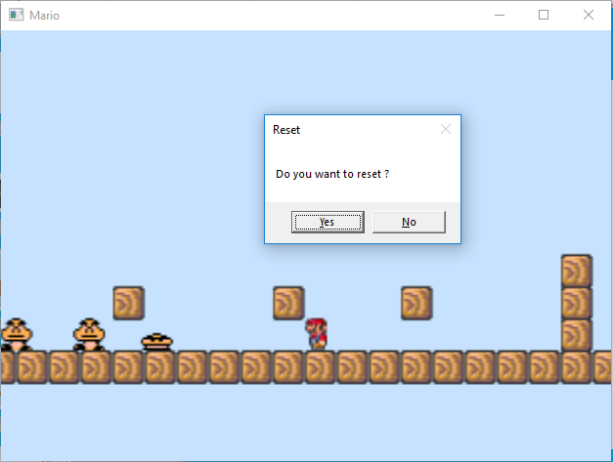
Solution
Press R to reset

Slide 10
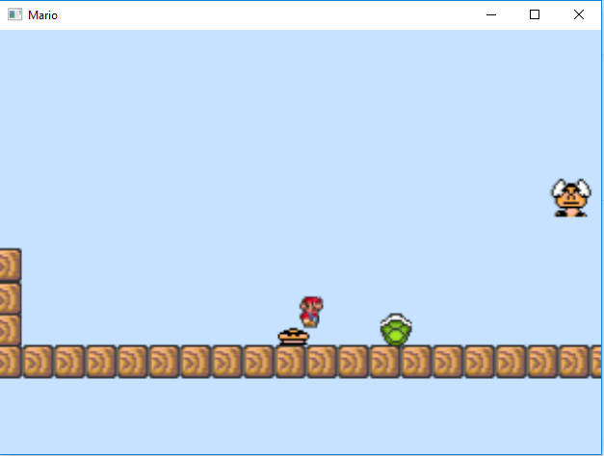
Solution
Jump on top to kill.
You can move to death Koopas to make it move faster.

Slide 11
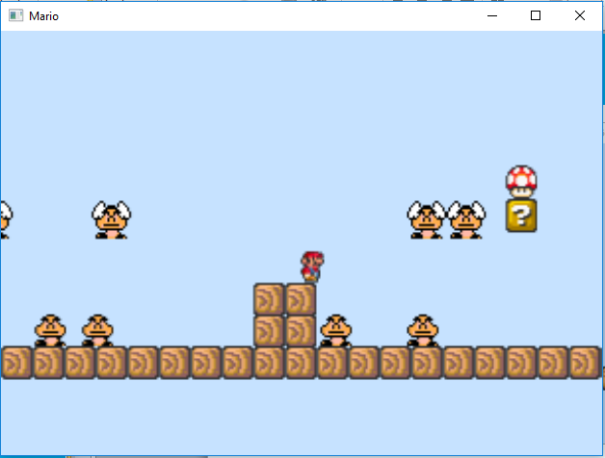
Solution
Eat mushroom to level up mario when you small.

Slide 12
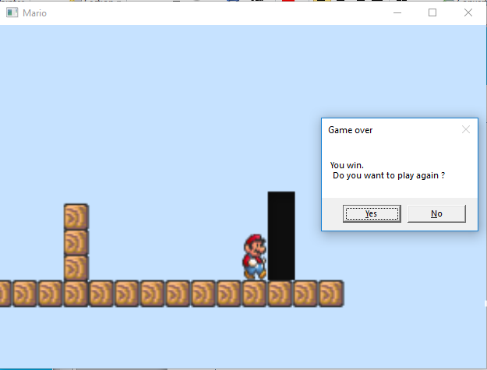
Solution
When you come to the final world. This MessageBox will show up.
If you choose No: the program will exit.
If you choose Yes: you will transport to the main map.

Slide 13
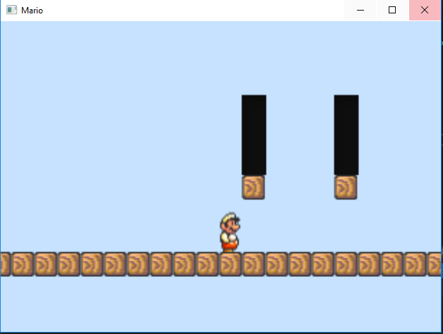
Solution
This is the main map.
You will have 2 portal to choose to play again.

Slide 14

3.Evaluation

Slide 15
Evaluation
1.Advantages
The program runs well in Window 10.
There are 2 world to play.
2.Disadvantages
Have some bug when you meet portal.
If you dead, you had to press R to play again.

Slide 16
Future development
Make more world.
Fix bugs.
Make more enemies and form of mario.
- Make start screen.

Slide 17


